Slide 1

Graph Theory and Its Applications
Community Detection
Dr. Arti Arya
Department of Computer Science
and Engineering

Slide 2

Graph Theory and Its Applications Acknowledgement
The course slides are prepared by Prof. BhaskarJyoti. But various major inputs are added by me from various reliable resources from Foreign and Indian Universities as well as from sites.
Notes:
Ok. Having said that, lets get back to what we were speaking about.
Input devices. We have seen that the virtual reality eco system largely encompasses three fundamental components that include
HMD – head mounted devices that give you immersive VR experience, we saw some examples in the last class like the HTC VIVE, Oculus Rift, Samsung gear and so on. Some of you have also used few of these and experienced it for a few minutes.
And the second components is the GTD or the Gesture Tracking Devices. We saw a video of Xsense IMU sensors that can accurately estimation the position and orientation of a dancer. we will in the next hour see how these gesture tracking devices work and what are the various technicalities that go into tracking. I will try to keep it as non-mathematical as possible, as the mathematics behind it can get pretty messy and complicated. However, if you are interested in the mathematical aspects, I will be more than happy to discuss.
On the screen you can see that a 3 directional coordinate system is depicted. The 3 primary axes of a 3d coordinate system is X, Y and Z axis. Hear I would like to know where, when and why in your past have you encountered 3 dimensional coordinate system.
Give some time to the students to ponder on
Ok, if I tell you, I have encountered 2 dimension in images, drawings, sketch and so on. While I have encountered 1 dimension when I want to know the temperature currently or current time or something like that. Similar, where and when have you encountered 3D, either consciously or subconsciously.
Explain the roll pitch and yaw concepts.
Degree of freedom

Slide 3

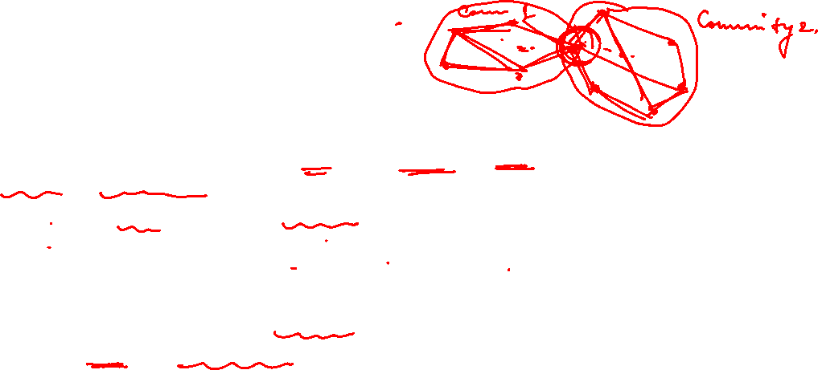
Graph Theory and Its Applications
What is community detection
The process of finding clusters/groups/cohesive subgroups of nodes (‘‘communities’’)
With Strong internal connections and
Weak connections between different communities
Ideal decomposition of a large graph
Completely disjoint communities
There are no interactions between different communities.
In practice,
find community partitions that are maximally decoupled.

Slide 4
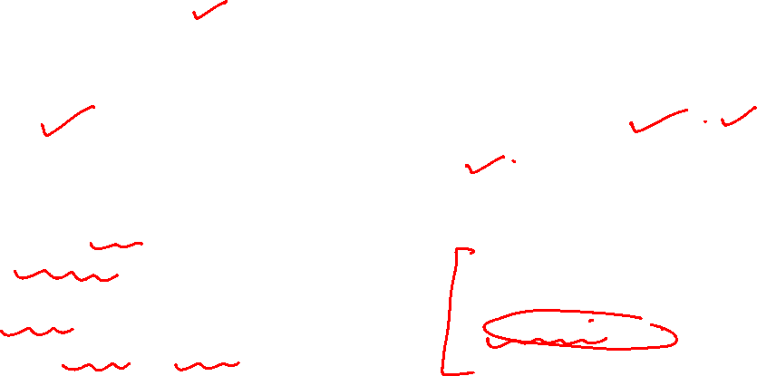
Graph Theory and Its Applications
Types of Communities
Communities
Explicit/Emic
Implicit/Etic
Individuals interact with each other tacitly.
Eg a person calling someone in Dubai from India on a daily basis need not be friends. But from phone operator point of view they form an implicit community.
2. Consider people with same taste for movies on a movie rental site.
Community members understand that they are its members.
Non-members understand who the community members are.
Community members often have more interactions with each other than with non-members

Slide 5
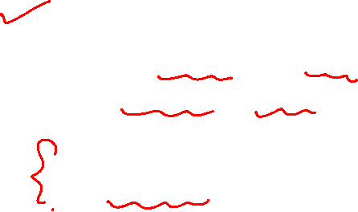
Graph Theory and Its Applications
Examples of Explicit Communities/ Implicit Communities
EXPLICIT
Facebook
Yahoo! Groups
LinkedIn
IMPLICIT
Like people on movie rental site with similar taste for movies
They will rarely be the members of same Explicit community.
But movie rental site is specifically be interested

Slide 6
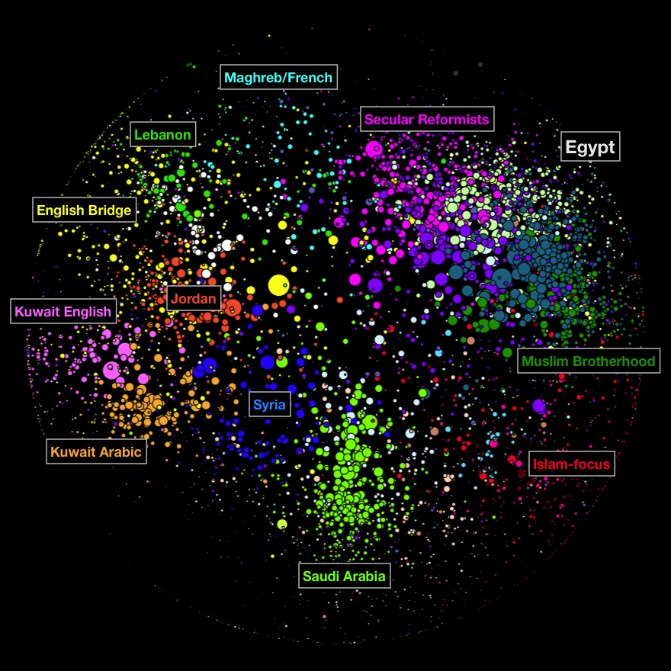
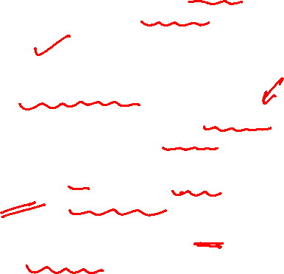
Graph Theory and Its Applications
Why community detection?
Network Summarization
A community can be considered as a summary of the whole network
Easier to visualize and understand
Preserve Privacy
[Sometimes] a community can reveal some properties without releasing the individuals’ privacy information.
Implicit communities are often more useful. Community detection is really around that.

Slide 7
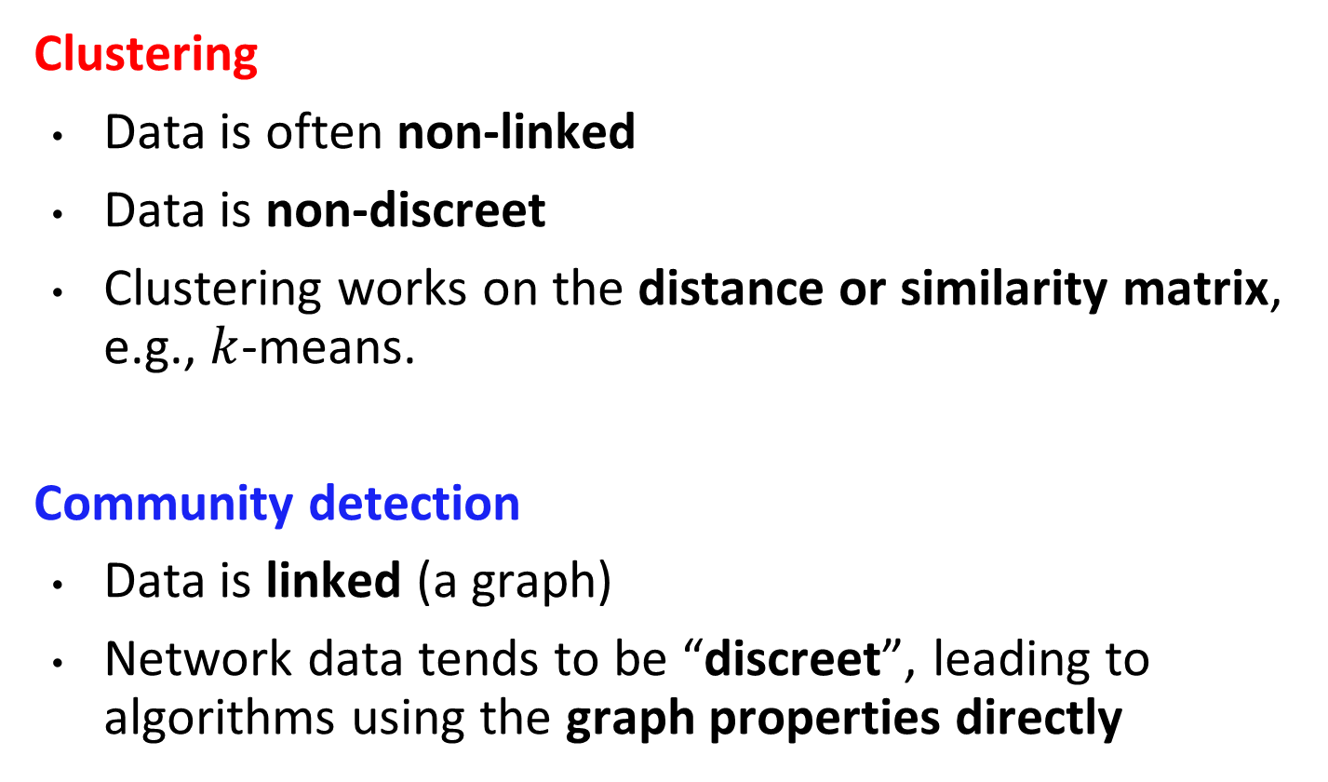
Graph Theory and Its Applications
Community detection vs. Clustering
Clustering
Data is often non-linked
Data is non-discreet
Clustering works on the distance or similarity matrix, e.g., $k$-means.
Community detection
Data is linked (a graph)
Network data tends to be “discreet”, leading to algorithms using the graph properties directly

Slide 8
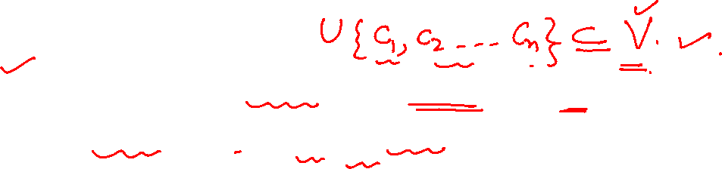
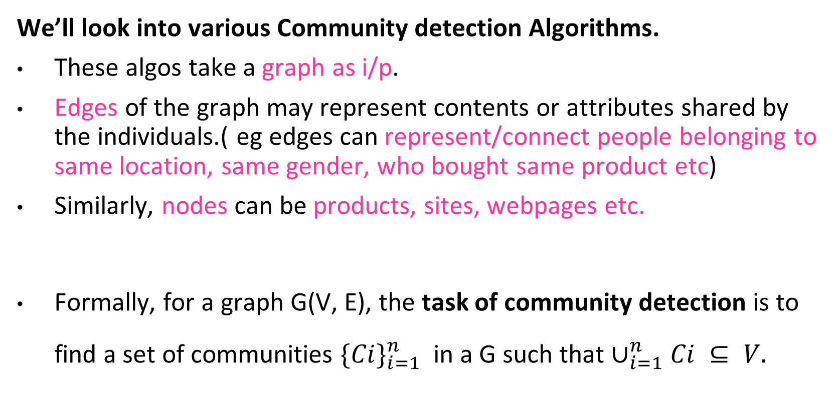
Graph Theory and Its Applications
Community detection vs. Clustering
We’ll look into various Community detection Algorithms.
These algos take a graph as i/p.
Edges of the graph may represent contents or attributes shared by the individuals.( eg edges can represent/connect people belonging to same location, same gender, who bought same product etc)
Similarly, nodes can be products, sites, webpages etc.
Formally, for a graph G(V, E), the task of community detection is to find a set of communities ${\{Ci\}}_{i=1}^{n}$in a G such that $∪_{i=1}^{n}Ci ⊆ V.$

Slide 9
NETWORK ANALYSIS AND MINING
Our plan for Community detection
Our plan
We will learn three specific algorithms
Clique Percolation Method
Girvan Newman
Louvain
We will then look at the community detection big picture and understand where everything fits
We finally look at how to evaluate

Slide 10
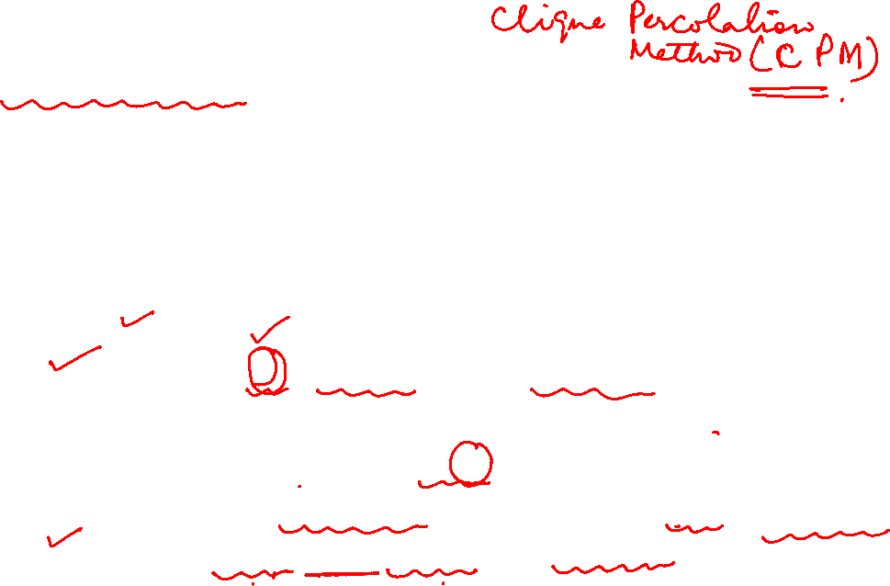
Graph Theory and Its Applications
Clique Percolation Method – use clique as seed
When using cliques as a seed or core of a community, we assume communities are formed from a set of cliques (small or large) in addition to edges that connect these cliques.
Input
A parameter k (clique size) , and a network
Algorithm ( require parameter k )
Cliques_{k} = all cliques of size k in the given network
Construct a clique graph G (V,E) such that |V| = |Cliques_{k}|
E = {e_{ij} | clique i and clique j share k-1 nodes}
Return all connected components of G

Slide 11
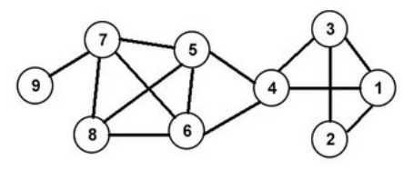

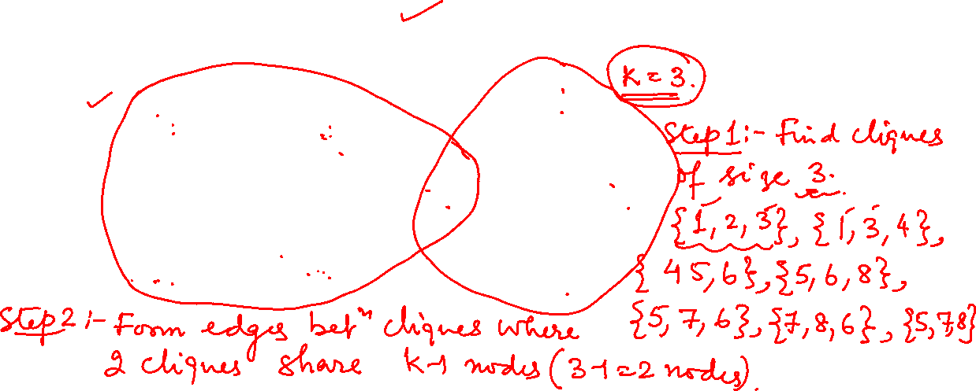
Graph Theory and Its Applications
Clique Percolation Method – use clique as seed

Slide 12
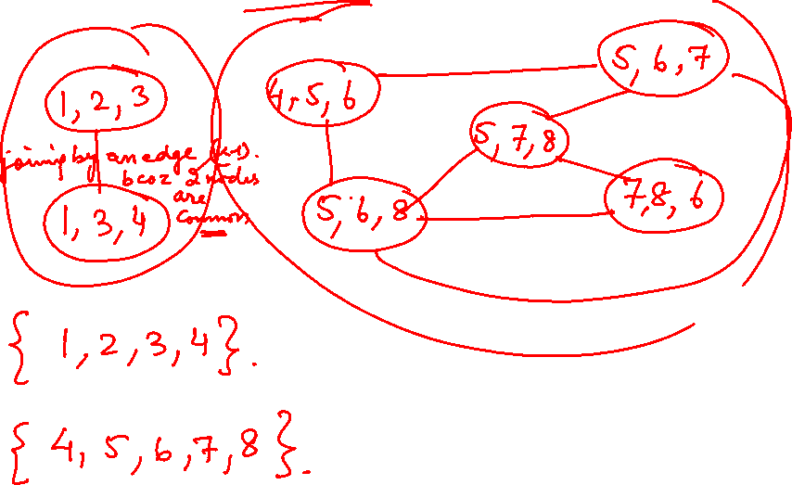

Slide 13
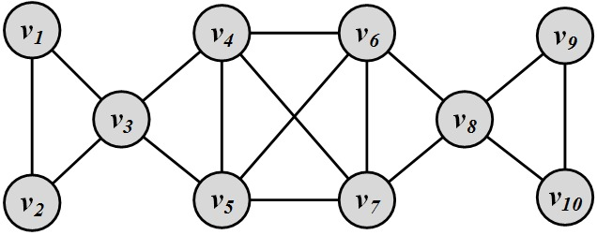
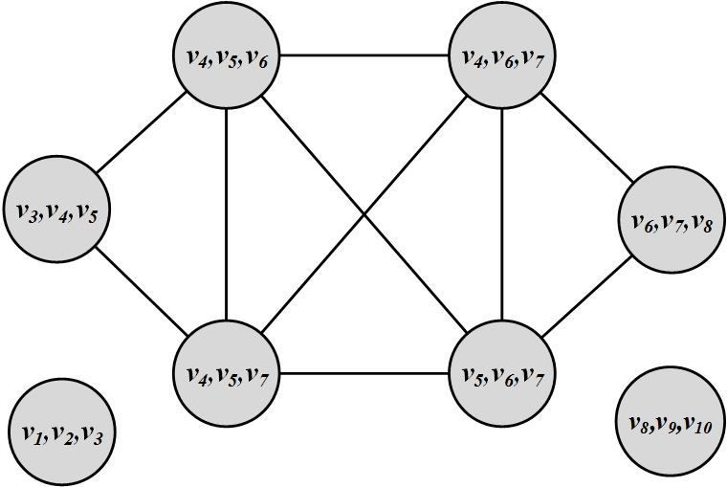
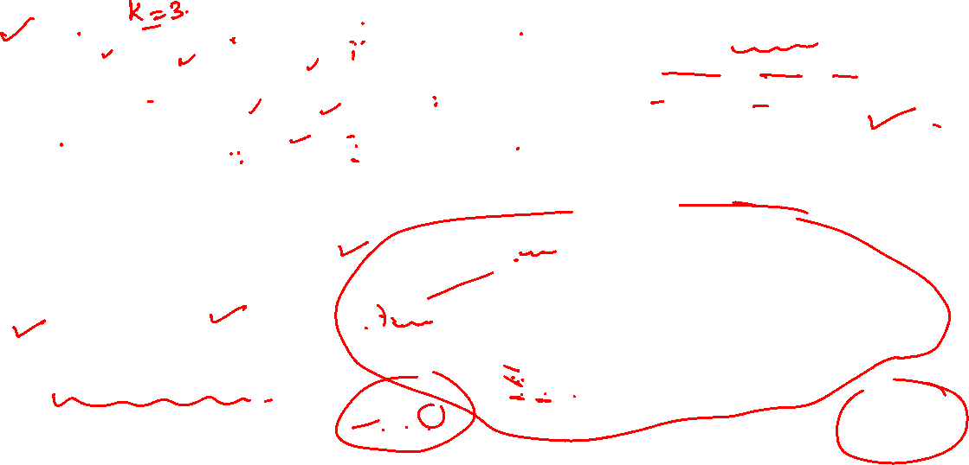
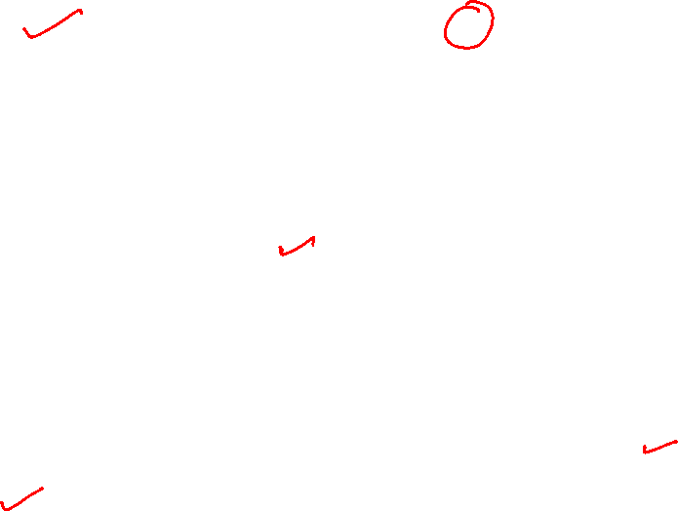
Graph Theory and Its Applications
Example using clique of size 3
Cliques of size 3:
{1, 2, 3}, {3, 4,5}, {4, 5, 7}, {4,5, 6}, {4,6,7}, {5,6, 7}, {6, 7, 8}, {8,9,10}
Communities:
{1, 2, 3} {8,9,10}
{3,4, 5, 6, 7, 8}

Slide 14
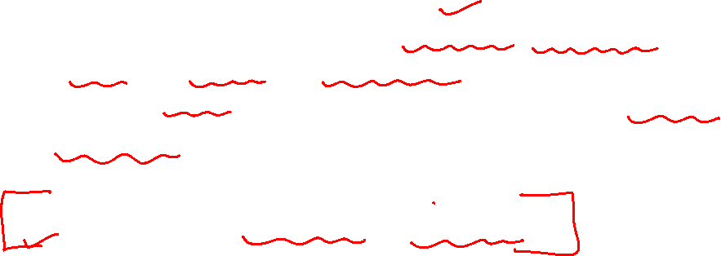
Graph Theory and Its Applications
CPM – points to note
The algorithm searches for all cliques of size k and is therefore computationally intensive. In practice, when using the CPM algorithm, we often solve for a small k to perform faster.
CPM can return overlapping communities.

Slide 15

Graph Theory and Its Applications
Finding Overlapped Communities by CPM
Clique of size 3 : Complete graph with 3 vertices
clique of size 3

Slide 16

Graph Theory and Its Applications
Finding Overlapped Communities by CPM
Clique of size 4 : Complete graph with 4 vertices
Clique of size 4

Slide 17
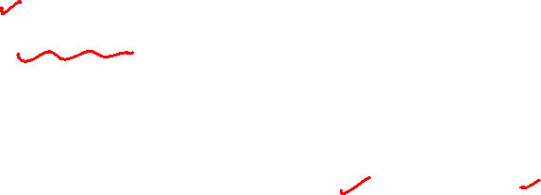
Graph Theory and Its Applications
Finding Overlapped Communities by CPM
Clique of size 5 : Complete graph with 5 vertices
Clique of size 5

Slide 18
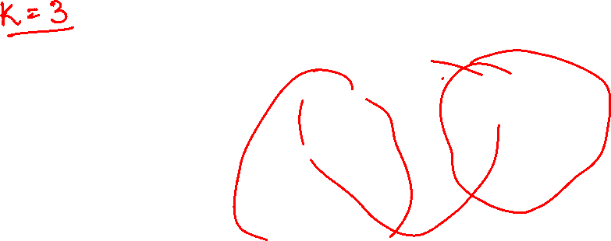
Graph Theory and Its Applications
Finding Overlapped Communities by CPM
Adjacent cliques of size K
Two cliques of size K are adjacent when they share k-1 nodes
k = 3
K=3

Slide 19
Graph Theory and Its Applications
Finding Overlapped Communities by CPM
Adjacent cliques of size K
Two cliques of size K are adjacent when they share k-1 nodes
k = 3
K=3
Clique 1:

Slide 20
Graph Theory and Its Applications
Finding Overlapped Communities by CPM
Adjacent cliques of size K
Two cliques of size K are adjacent when they share k-1 nodes
K=3, Clique 2
k = 3

Slide 21
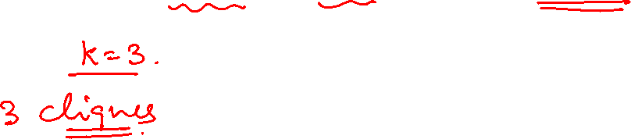
Graph Theory and Its Applications
Finding Overlapped Communities by CPM
Adjacent cliques of size K
Two cliques of size K are adjacent when they share k-1 nodes
Clique 3
K=3, Clique 3
k = 3

Slide 22
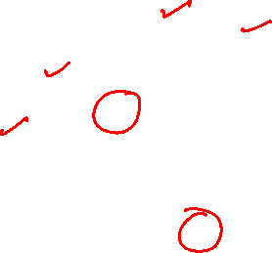
Graph Theory and Its Applications
Finding Overlapped Communities by CPM
Adjacent cliques of size K
Two cliques of size K are adjacent when they share k-1 nodes
Clique 2
k = 3
Clique-1 and Clique-2 are adjacent because they share k-1 nodes
Clique 1

Slide 23
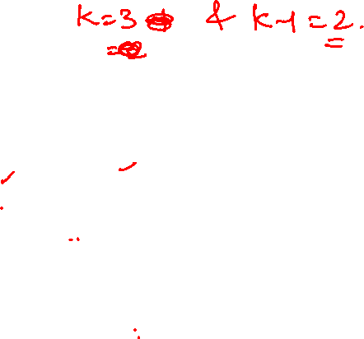
Graph Theory and Its Applications
Finding Overlapped Communities by CPM
Adjacent cliques of size K
Two cliques of size K are adjacent when they share k-1 nodes
Clique 2
Clique 3
Clique 2 Clique 3
Clique-2 and Clique-3 are not adjacent because they are not sharing k-1 nodes
k = 3

Slide 24

Graph Theory and Its Applications
Finding Overlapped Communities by CPM
Clique Community by CPM
Union of all cliques of size k that can be reached from each other.

Slide 25

Graph Theory and Its Applications
Finding Overlapped Communities by CPM
Clique Community by CPM
Union of all cliques of size k that can be reached from each other.
Clique 2
k = 3
Clique 1

Slide 26

Graph Theory and Its Applications
Finding Overlapped Communities by CPM
Clique Community by CPM
Union of all cliques of size k that can be reached from each other.
Clique Community
Community 1
k = 3

Slide 27
Graph Theory and Its Applications
Finding Overlapped Communities by CPM
Clique Community by CPM
Union of all cliques of size k that can be reached from each other.
Community 1
Clique 3
k = 3

Slide 28
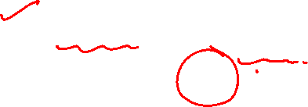
Graph Theory and Its Applications
Finding Overlapped Communities by CPM
Clique Community by CPM
Union of all cliques of size k that can be reached from each other.
Clique Communities
Community 1
Community 2
k = 3
Community-1 and Community-2 are overlapped

Slide 29
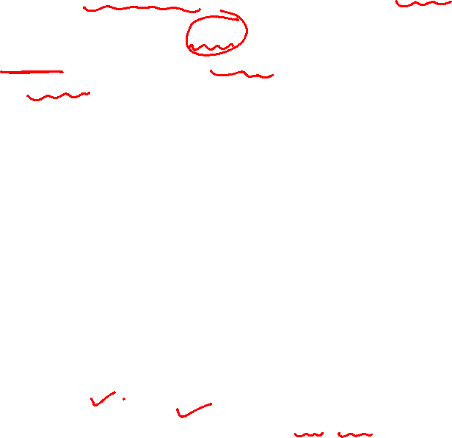
Graph Theory and Its Applications
Finding Overlapped Communities by CPM
Problem: Given G and k=4. Find communities and overlapped communities using CPM.
10
1
4
5
9
8
2
3
Note: k indicates finding communities of size k or more.

Slide 30
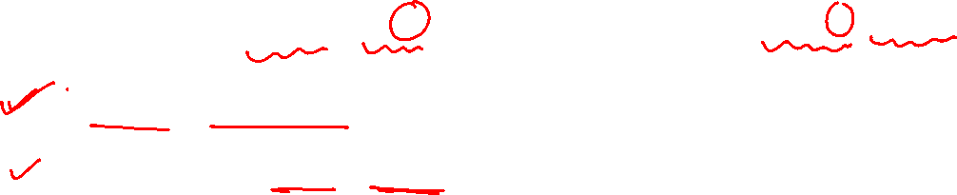
Algorithm: Input: Given graph G, and k (k: find communities of size k or more)
Graph Theory and Its Applications
Finding Overlapped Communities by CPM : Algorithm
Locate maximal cliques
Convert from cliques to communities

Slide 31
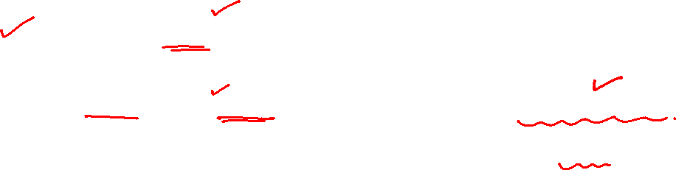
1. Locate Maximal Cliques
Graph Theory and Its Applications
Finding Overlapped Communities by CPM
Largest possible clique size can be determined from degrees of vertices
Starting from this size, find all cliques, then reduce size by 1 and repeat

Slide 32
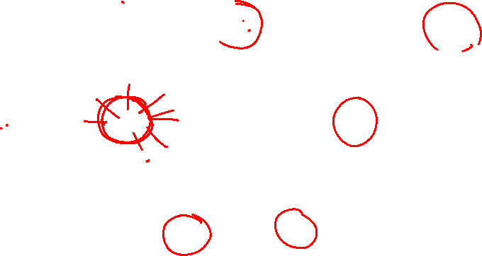
Graph Theory and Its Applications
Finding Overlapped Communities by CPM
Locate maximal cliques
10
1
4
5
9
8
2
3
6
7

Slide 33
Graph Theory and Its Applications
Finding Overlapped Communities by CPM
Locate maximal cliques
Clique 1: 5-clique
A 5-clique contains five 4-cliques
Notes:
Note: 5-clique is a combination of five 4-cliques (5-clique contains five 4-cliques)

Slide 34
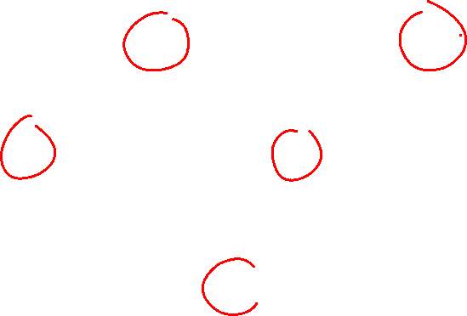
Graph Theory and Its Applications
Finding Overlapped Communities by CPM
Locate maximal cliques

Slide 35
Graph Theory and Its Applications
Finding Overlapped Communities by CPM
Locate maximal cliques
Clique 2: 4-clique

Slide 36
Graph Theory and Its Applications
Finding Overlapped Communities by CPM
Locate maximal cliques

Slide 37
Graph Theory and Its Applications
Finding Overlapped Communities by CPM
Locate maximal cliques
Clique 3: 4-clique

Slide 38
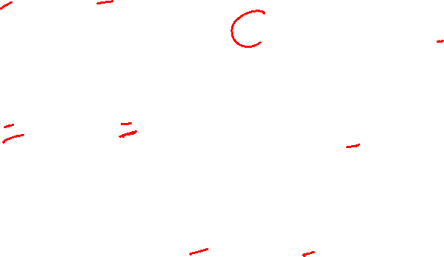
Graph Theory and Its Applications
Finding Overlapped Communities by CPM
Locate maximal cliques

Slide 39
Graph Theory and Its Applications
Finding Overlapped Communities by CPM
Locate maximal cliques
Clique 4: 4-clique

Slide 40

Graph Theory and Its Applications
Finding Overlapped Communities by CPM
Locate maximal cliques

Slide 41
Graph Theory and Its Applications
Finding Overlapped Communities by CPM
Locate maximal cliques
Clique 5: 3-clique

Slide 42

Graph Theory and Its Applications
Finding Overlapped Communities by CPM
Locate maximal cliques

Slide 43
Graph Theory and Its Applications
Finding Overlapped Communities by CPM
Locate maximal cliques
Clique 6: 3-clique

Slide 44

Algorithm
Graph Theory and Its Applications
Finding Overlapped Communities by CPM
Locate maximal cliques
Convert from cliques to communities

Slide 45
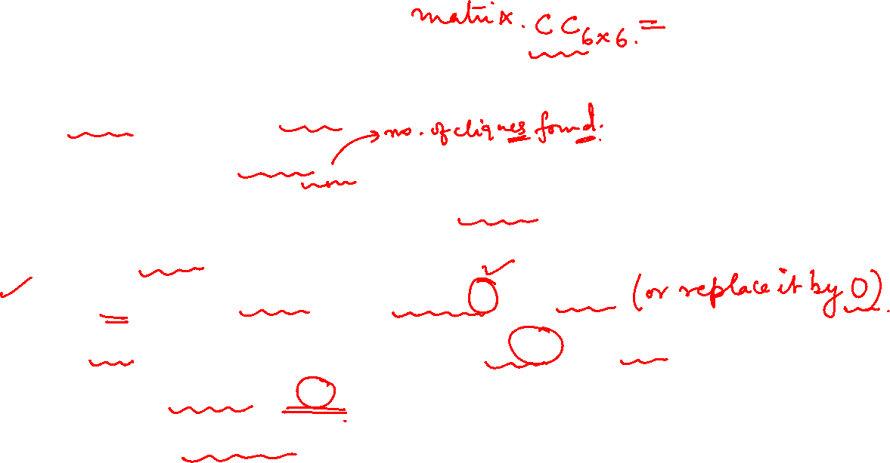
Graph Theory and Its Applications
Finding Overlapped Communities by CPM
2. Convert from cliques to k-clique communities
Create a square matrix CC_{n×n}, where n is the number of cliques found. Each cell CC[i, j] contains number of nodes shared by cliques C_{i} and C_{j}.
If CC[i,i] (diagonal elements )is less than k, then delete.
If CC[i,j] (non-diagonal elements) is less than k-1, then delete.
Change all non-zeros to 1.
Combine adjacent cliques to form a community.

Slide 46
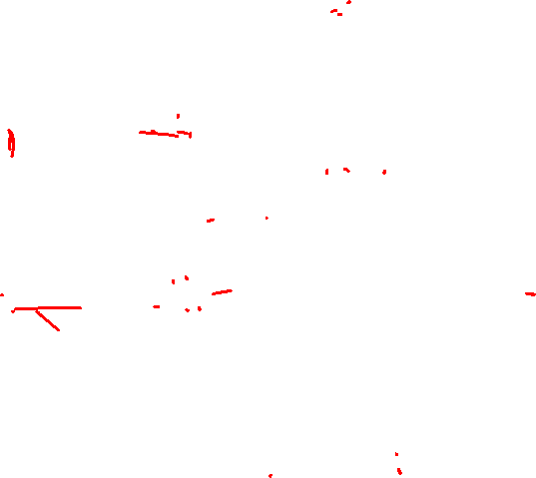
Graph Theory and Its Applications
Finding Overlapped Communities by CPM
Cliques to k-Clique Communities
Clique-5
Clique-3
Clique-6
Clique-2
Clique-1
Clique-4

Slide 47
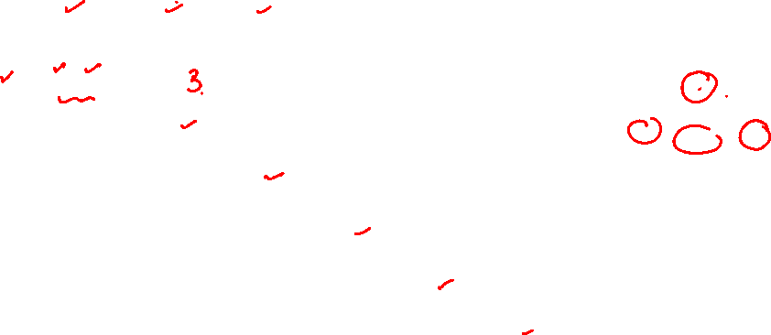
Graph Theory and Its Applications
Finding Overlapped Communities by CPM
Cliques to k-Clique Communities
 | C₁ | C₂ | C₃ | C₄ | C₅ | C₆
C₁ | 5
C₂ |  | 4
C₃ |  |  | 4
C₄ |  |  |  | 4
C₅ |  |  |  |  | 3
C₆ |  |  |  |  |  | 3
Step-a: Construct a matrix CC_{n×n} ,where n represents the total number of cliques. Each cell CC[i, j] contains number of nodes shared by cliques C_{i} and C_{j}.

Slide 48
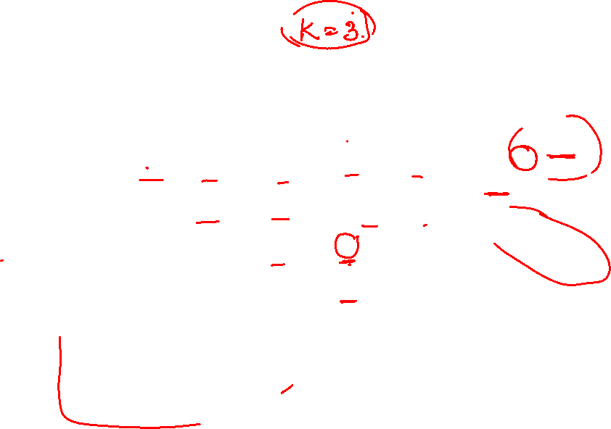
Graph Theory and Its Applications
Finding Overlapped Communities by CPM
Cliques to k-Clique Communities
 | C₁ | C₂ | C₃ | C₄ | C₅ | C₆
C₁ | 5 | 3 | 1 | 3 | 1 | 2
C₂ | 3 | 4 | 1 | 1 | 1 | 2
C₃ | 1 | 1 | 4 | 2 | 1 | 2
C₄ | 3 | 1 | 2 | 4 | 0 | 1
C₅ | 1 | 1 | 1 | 0 | 3 | 2
C₆ | 2 | 2 | 2 | 1 | 2 | 3
Step-a: Construct a matrix CC_{n×n} ,where n represents the total number of cliques. Each cell CC[i, j] contains number of nodes shared by cliques C_{i} and C_{j}.
Notes:
Clique overlap matrix

Slide 49
Graph Theory and Its Applications
Finding Overlapped Communities by CPM
Cliques to k-Clique Communities
 | C₁ | C₂ | C₃ | C₄ | C₅ | C₆
C₁ | 5 | 3 | 1 | 3 | 1 | 2
C₂ | 3 | 4 | 1 | 1 | 1 | 2
C₃ | 1 | 1 | 4 | 2 | 1 | 2
C₄ | 3 | 1 | 2 | 4 | 0 | 1
C₅ | 1 | 1 | 1 | 0 | 3 | 2
C₆ | 2 | 2 | 2 | 1 | 2 | 3
Symmetric Matrix
Notes:
A symmetric matrix is a square matrix that is equal to its transpose.

Slide 50
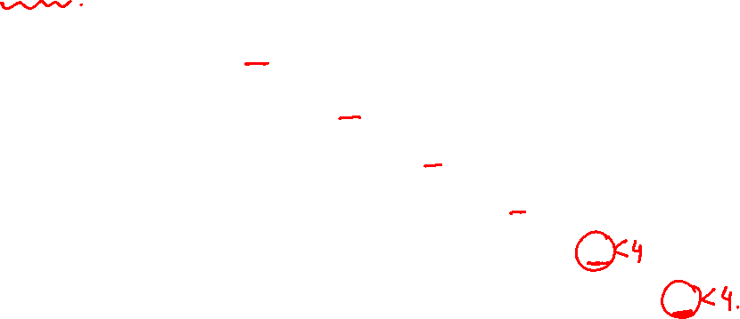
Graph Theory and Its Applications
Finding Overlapped Communities by CPM
Cliques to k-Clique Communities
Given k=4
 | C₁ | C₂ | C₃ | C₄ | C₅ | C₆
C₁ | 5 | 3 | 1 | 3 | 1 | 2
C₂ | 3 | 4 | 1 | 1 | 1 | 2
C₃ | 1 | 1 | 4 | 2 | 1 | 2
C₄ | 3 | 1 | 2 | 4 | 0 | 1
C₅ | 1 | 1 | 1 | 0 | 3 | 2
C₆ | 2 | 2 | 2 | 1 | 2 | 3
Note: Given k in problem statement represents Community size
(i.e., find communities of size k or more)

Slide 51
Graph Theory and Its Applications
Finding Overlapped Communities by CPM
Cliques to k-Clique Communities
k=4
 | C₁ | C₂ | C₃ | C₄ | C₅ | C₆
C₁ | 5 | 3 | 1 | 3 | 1 | 2
C₂ | 3 | 4 | 1 | 1 | 1 | 2
C₃ | 1 | 1 | 4 | 2 | 1 | 2
C₄ | 3 | 1 | 2 | 4 | 0 | 1
C₅ | 1 | 1 | 1 | 0 | 3 | 2
C₆ | 2 | 2 | 2 | 1 | 2 | 3
Step-b: If CC[i,i] is less than k, then delete

Slide 52
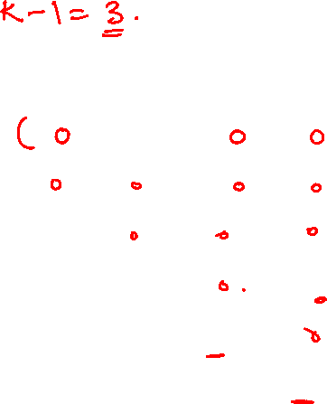
Graph Theory and Its Applications
Finding Overlapped Communities by CPM
Cliques to k-Clique Communities
k=4
 | C₁ | C₂ | C₃ | C₄ | C₅ | C₆
C₁ | 5 | 3 | 1 | 3 | 1 | 2
C₂ | 3 | 4 | 1 | 1 | 1 | 2
C₃ | 1 | 1 | 4 | 2 | 1 | 2
C₄ | 3 | 1 | 2 | 4 | 0 | 1
C₅ | 1 | 1 | 1 | 0 | 0 | 2
C₆ | 2 | 2 | 2 | 1 | 2 | 0

Slide 53
Graph Theory and Its Applications
Finding Overlapped Communities by CPM
Cliques to k-Clique Communities
k=4
 | C₁ | C₂ | C₃ | C₄ | C₅ | C₆
C₁ | 5 | 3 | 1 | 3 | 1 | 2
C₂ | 3 | 4 | 1 | 1 | 1 | 2
C₃ | 1 | 1 | 4 | 2 | 1 | 2
C₄ | 3 | 1 | 2 | 4 | 0 | 1
C₅ | 1 | 1 | 1 | 0 | 0 | 2
C₆ | 2 | 2 | 2 | 1 | 2 | 0
Step-c: If CC[i,j] is less than k-1, then delete

Slide 54

Graph Theory and Its Applications
Finding Overlapped Communities by CPM
Cliques to k-Clique Communities
k=4
 | C₁ | C₂ | C₃ | C₄ | C₅ | C₆
C₁ | 5 | 3 | 0 | 3 | 0 | 0
C₂ | 3 | 4 | 0 | 0 | 0 | 0
C₃ | 0 | 0 | 4 | 0 | 0 | 0
C₄ | 3 | 0 | 0 | 4 | 0 | 0
C₅ | 0 | 0 | 0 | 0 | 0 | 0
C₆ | 0 | 0 | 0 | 0 | 0 | 0

Slide 55
Graph Theory and Its Applications
Finding Overlapped Communities by CPM
Cliques to k-Clique Communities
k=4
 | C₁ | C₂ | C₃ | C₄ | C₅ | C₆
C₁ | 5 | 3 | 0 | 3 | 0 | 0
C₂ | 3 | 4 | 0 | 0 | 0 | 0
C₃ | 0 | 0 | 4 | 0 | 0 | 0
C₄ | 3 | 0 | 0 | 4 | 0 | 0
C₅ | 0 | 0 | 0 | 0 | 0 | 0
C₆ | 0 | 0 | 0 | 0 | 0 | 0
Step-d: Change all non-zeros to 1

Slide 56
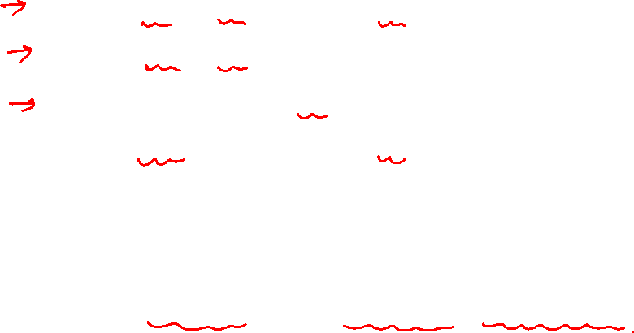
Graph Theory and Its Applications
Finding Overlapped Communities by CPM
Cliques to k-Clique Communities
k=4
 | C₁ | C₂ | C₃ | C₄ | C₅ | C₆
C₁ | 1 | 1 | 0 | 1 | 0 | 0
C₂ | 1 | 1 | 0 | 0 | 0 | 0
C₃ | 0 | 0 | 1 | 0 | 0 | 0
C₄ | 1 | 0 | 0 | 1 | 0 | 0
C₅ | 0 | 0 | 0 | 0 | 0 | 0
C₆ | 0 | 0 | 0 | 0 | 0 | 0
Step-e: Combine adjacent cliques to form a community.
Notes:
Row 1 indicates clique-1 is adjacent to itself, clique-2 and clique-4.
Row 2 indicates clique-2 is adjacent to clique-1 and itself.
Row 3 indicates clique-3 is adjacent to itself only.
Row 4 indicates clique-4 is adjacent to clique-1 and itslf.

Slide 57
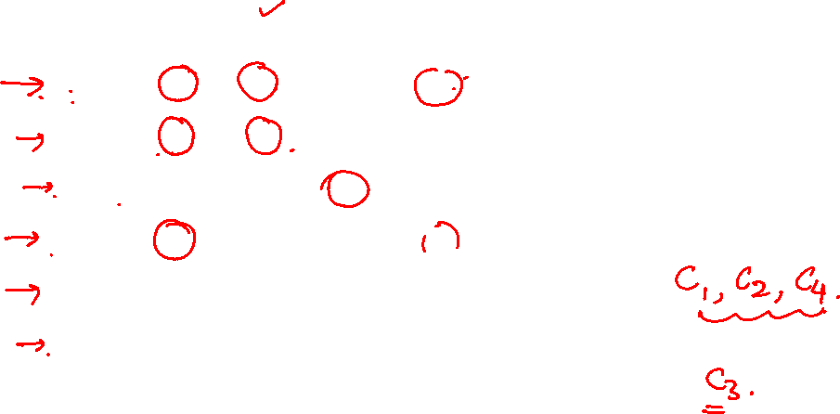
Graph Theory and Its Applications
Finding Overlapped Communities by CPM
Cliques to k-Clique Communities
 | C₁ | C₂ | C₃ | C₄ | C₅ | C₆
C₁ | 1 | 1 | 0 | 1 | 0 | 0
C₂ | 1 | 1 | 0 | 0 | 0 | 0
C₃ | 0 | 0 | 1 | 0 | 0 | 0
C₄ | 1 | 0 | 0 | 1 | 0 | 0
C₅ | 0 | 0 | 0 | 0 | 0 | 0
C₆ | 0 | 0 | 0 | 0 | 0 | 0
Clique-clique overlap matrix
Row 1 indicates clique-1 is adjacent to itself, clique-2 and clique-4.
Row 2 indicates clique-2 is adjacent to clique-1 and itself.
Row 3 indicates clique-3 is adjacent to itself only.
Row 4 indicates clique-4 is adjacent to clique-1 and itself.
Notes:
Row 1 indicates clique-1 is adjacent to itself, clique-2 and clique-4.
Row 2 indicates clique-2 is adjacent to clique-1 and itself.
Row 3 indicates clique-3 is adjacent to itself only.
Row 4 indicates clique-4 is adjacent to clique-1 and itself.

Slide 58
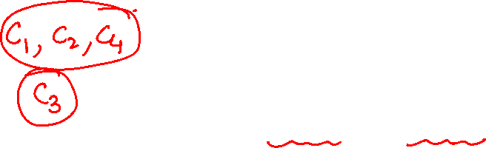
Graph Theory and Its Applications
Finding Overlapped Communities by CPM
Cliques to k-Clique Communities
 | C₁ | C₂ | C₃ | C₄ | C₅ | C₆
C₁ | 1 | 1 | 0 | 1 | 0 | 0
C₂ | 1 | 1 | 0 | 0 | 0 | 0
C₃ | 0 | 0 | 1 | 0 | 0 | 0
C₄ | 1 | 0 | 0 | 1 | 0 | 0
C₅ | 0 | 0 | 0 | 0 | 0 | 0
C₆ | 0 | 0 | 0 | 0 | 0 | 0
Clique-clique overlap matrix
Adjacent Cliques 1,2 and 4 form community-1 and Clique 3 alone form community-2
Notes:
Row 1 indicates clique-1 is adjacent to itself, clique-2 and clique-4.
Row 2 indicates clique-2 is adjacent to clique-1 and itself.
Row 3 indicates clique-3 is adjacent to itself only.
Row 4 indicates clique-4 is adjacent to clique-1 and itslf.

Slide 59
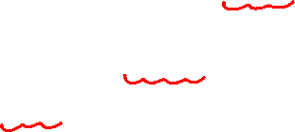
Graph Theory and Its Applications
Finding Overlapped Communities by CPM
Cliques to k-Clique Communities
Clique 2
Clique 1
Clique 4
Community 1

Slide 60

Graph Theory and Its Applications
Finding Overlapped Communities by CPM
Cliques to k-Clique Communities
Clique 3
Community 2

Slide 61
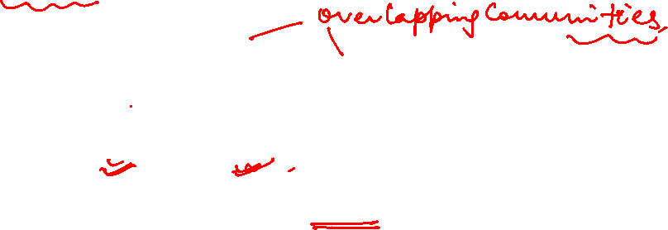
Graph Theory and Its Applications
Finding Overlapped Communities by CPM
Cliques to k-Clique Communities
Identified communities Community-1 and Community-2 are overlapped.
Community-2
Community-1

Slide 62
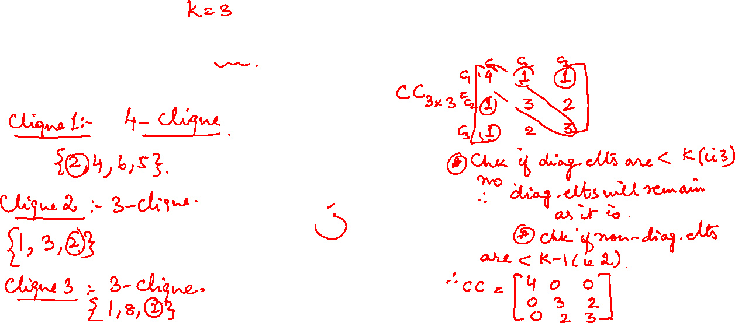
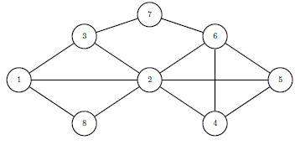
Graph Theory and Its Applications
Finding Overlapped Communities by CPM
Exercise 1: Find communities and overlapped communities of size greater than or equal to 3 using Clique Percolation Method (CPM). Show matrix computation.

Slide 63
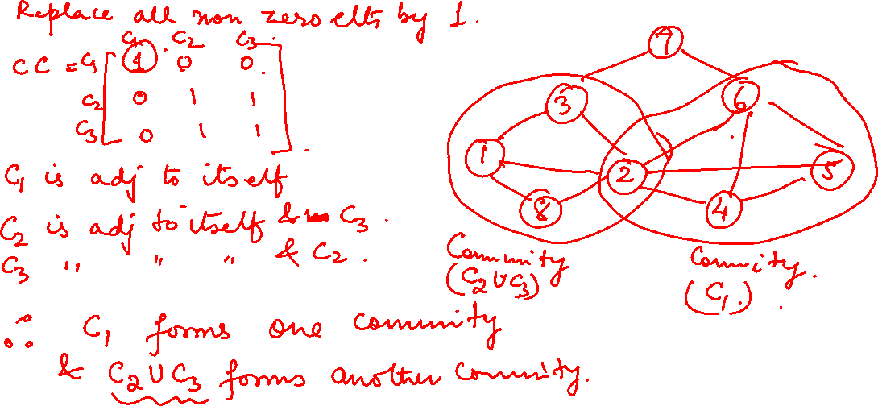

Slide 64
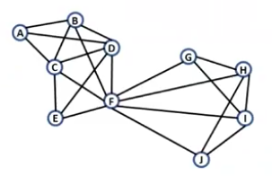
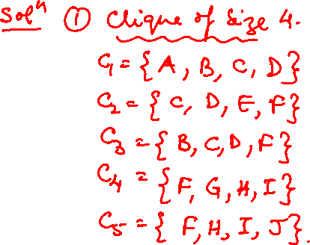
Graph Theory and Its Applications
Finding Overlapped Communities by CPM
Exercise 2: Given G and k=3, find communities and overlapped communities using CPM. Show matrix computation.

Slide 65
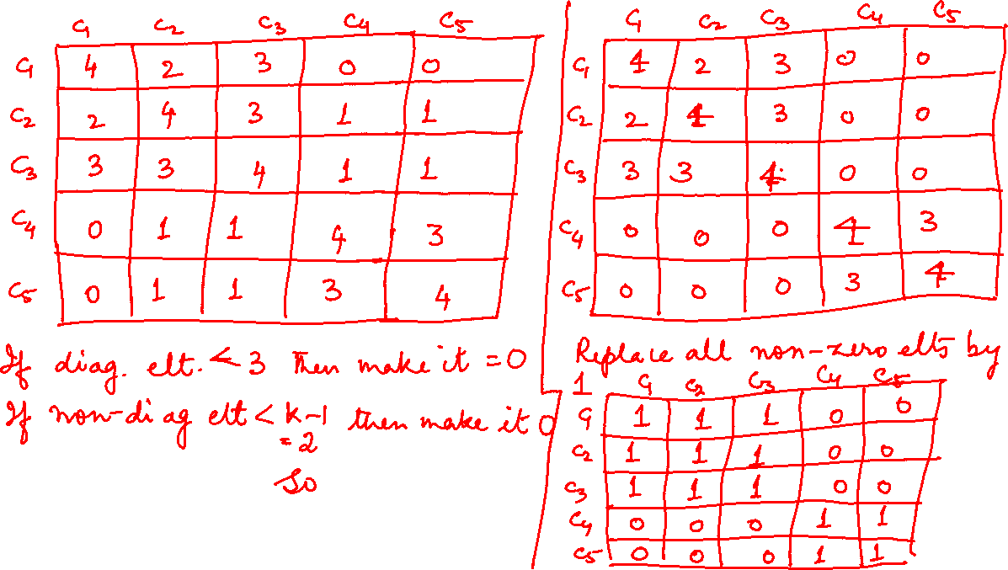

Slide 66
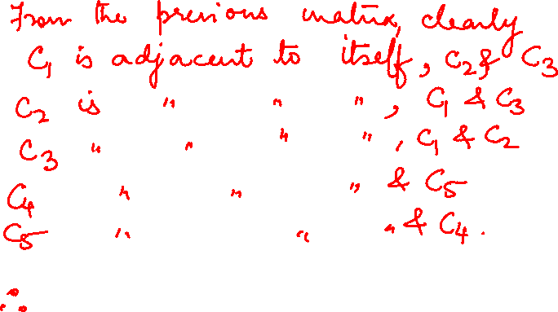
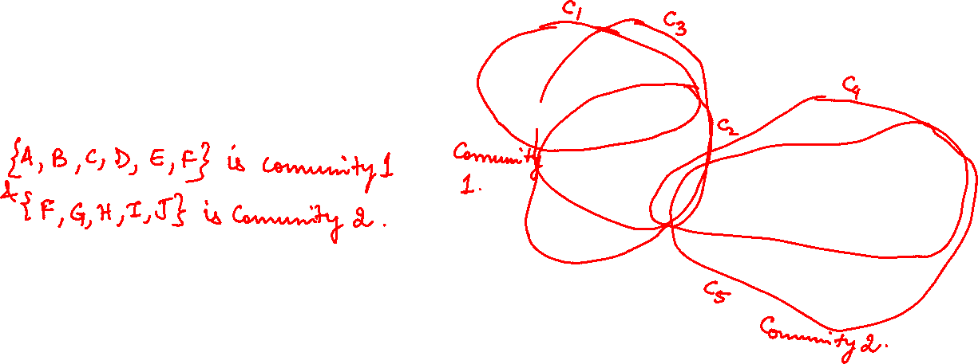

Slide 67
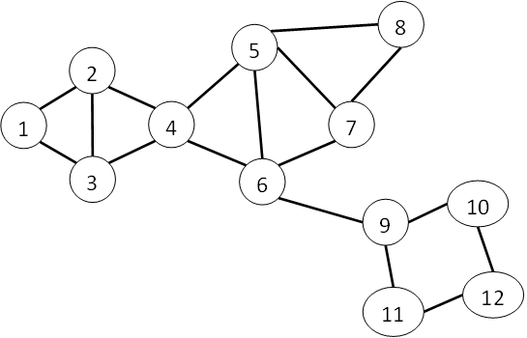

Graph Theory and Its Applications
Finding Overlapped Communities by CPM
Exercise 3: Given G and k=3, find communities and overlapped communities using CPM. Show matrix computation.

Slide 68
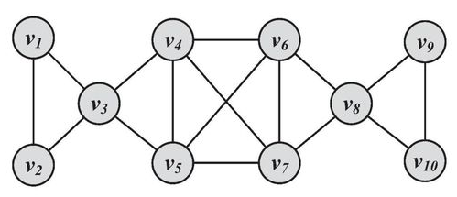
Graph Theory and Its Applications
Finding Overlapped Communities by CPM
Exercise 4: Given G and k=3, find communities and overlapped communities using CPM. Show matrix computation.

Slide 69

Graph Theory and Its Applications
Finding Overlapped Communities by CPM
Exercise 5: Given G and k=3, find communities and overlapped communities using CPM. Show matrix computation.

Slide 70
Graph Theory and Its Applications
CPM Algorithm

Slide 71
THANK YOU
Dr. Arti Arya
Department of Computer Science and Engineering

